Slide 1
Team MULTIFAN-CL: Indian Ocean yellowfin tuna
This is the Teal Title Slide, you can swap to the Blue 1 Title Slide or Blue2 Title Slide in the Layout menu
Spatial Stock Assessment Simulation Experiment
March 05, 2023
Workshop Update
Notes:
Overview of the terminology behind the main identifier.

Slide 2

Team MULTIFAN-CL
Claudio Castillo Jordan (SPC)
Nick Davies¹ (Te Takina Ltd.)
Jemery Day (SPC)
Nicholas Ducharme-Barth¹ (NOAA PIFSC)
Paul Hamer (SPC)
John Hampton (SPC)
Arni Magnusson (SPC)
Thom Teears (SPC)
Matthew Vincent¹ (NOAA SEFSC)
1. Former SPC staff members
Credit: GYPAETE AERIAL
SPC Campus, Nouméa, New Caledonia

Slide 3
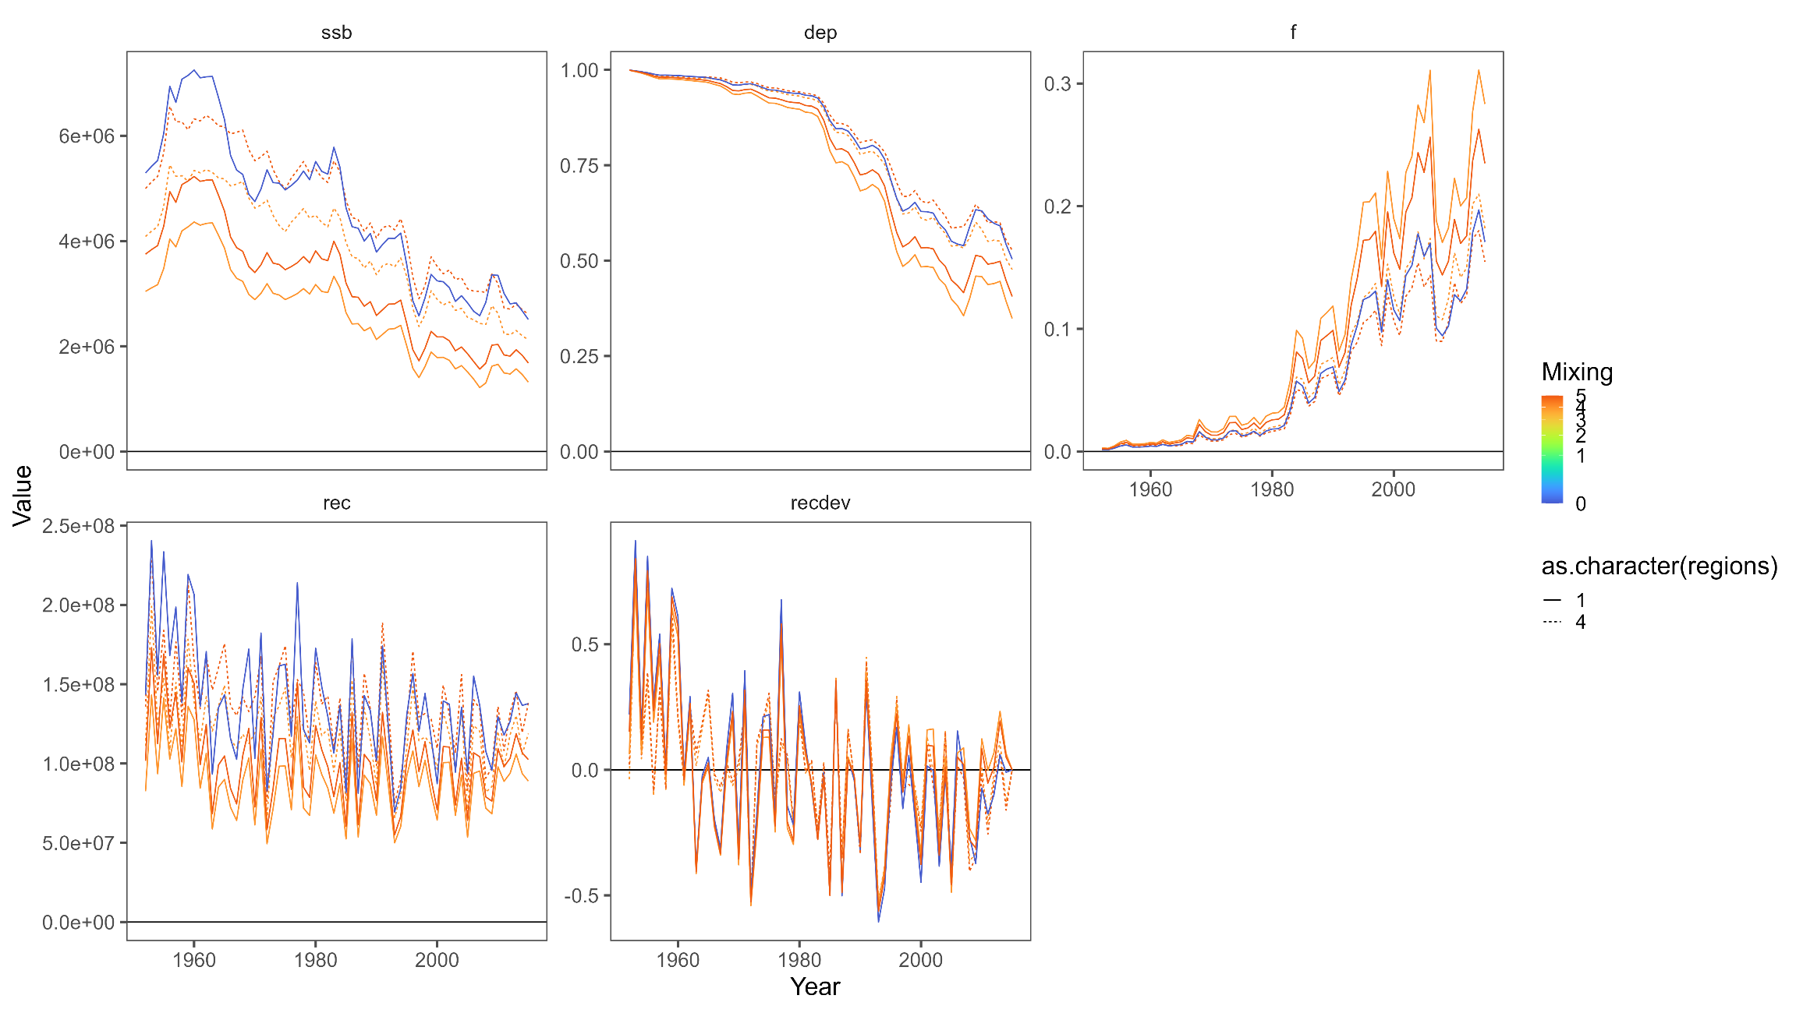
Recap – Current model comparison
Single region model estimates lower scale and more depleted state relative to four region model
Including tagging data lowers scale and depletion.
Shorter tag mixing periods lower scale and depletion.
Early recdev anomaly related to sparse early length comps since recruitment is unconstrained

Slide 4
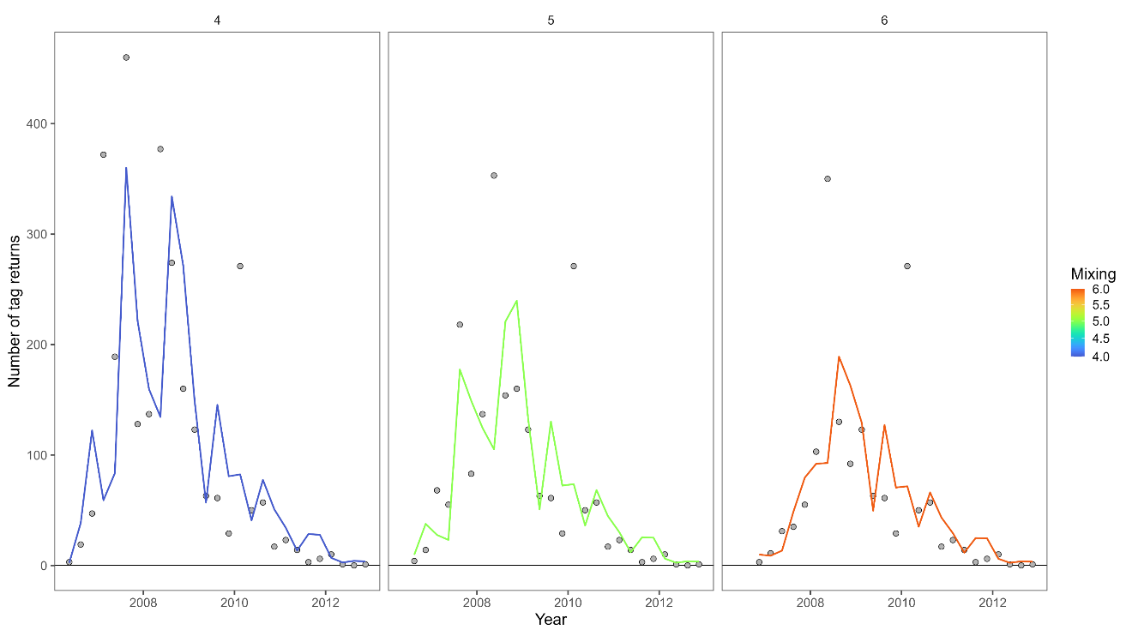
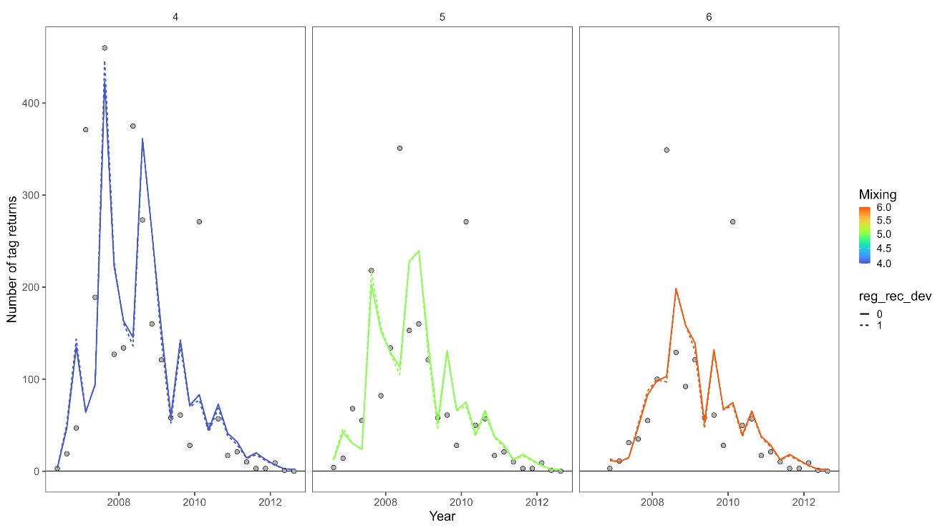
Recap – Current model comparison
Single region
Four region
Fits to the data components were comparable between model structures.
Fit to the tagging data is marginally improved with four region structure.

Slide 5
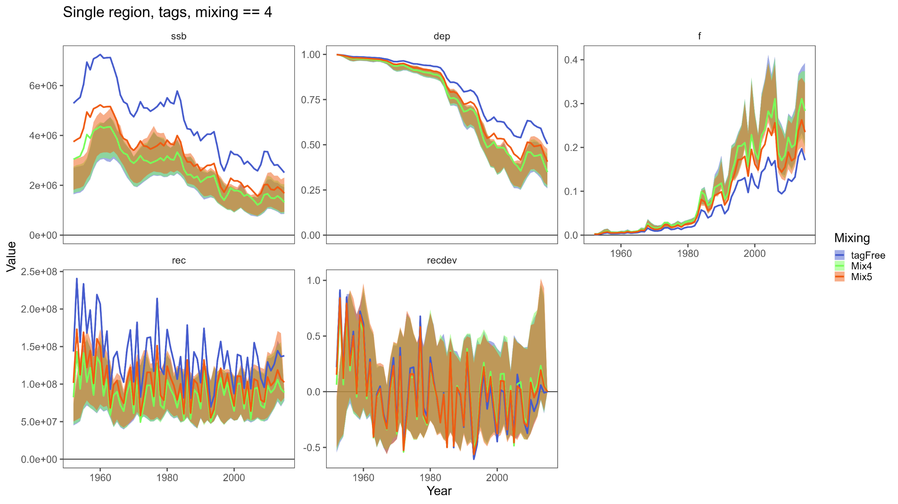
Recap – Replicate runs: single region
Previously we ran the replicates using the *_ESS_00x.Rdata rather than the *_ESS_05x.Rdata used in development of the test models.
*_ESS_00x data replicates showed little difference between tagging treatment and high levels of convergence across replicates (>85% four region, and >94% single region)
‘Final’ models using *_ESS_05x data outside of replicate range

Slide 6
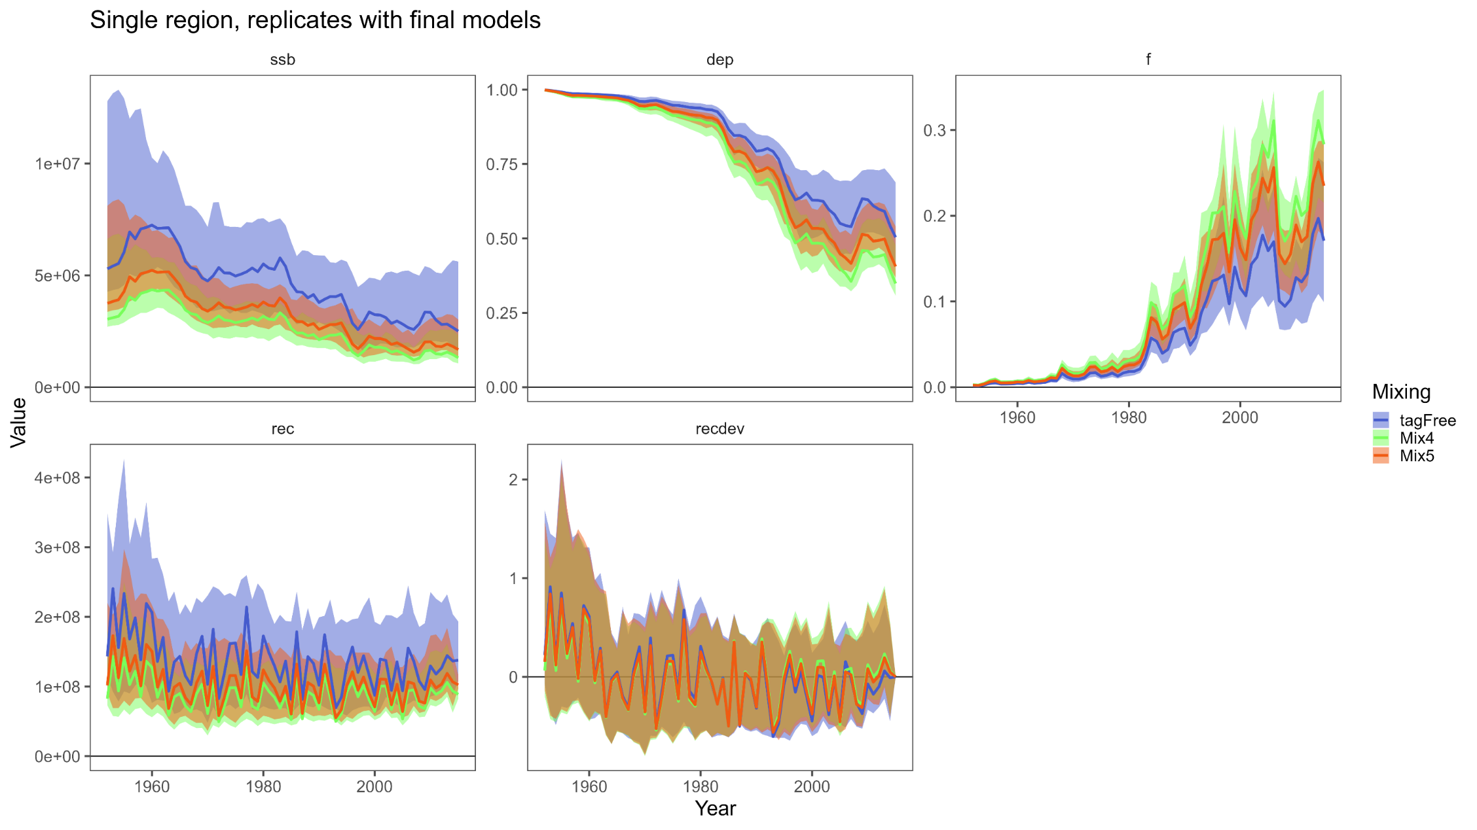
Single region replicates
Re-ran replicates with *_ESS_05x.Rdata used in model development.
‘Final’ models within replicate range
Convergence across replicates was poor (82% four region and 40-50% for single region).

Slide 7
Single region replicates
Similar to what was seen with ‘final’ models, inclusion of tagging data results in lower scale/depletion
Greater variability in results with *_ESS_05x.Rdata vs. *_ESS_00x.Rdata

Slide 8
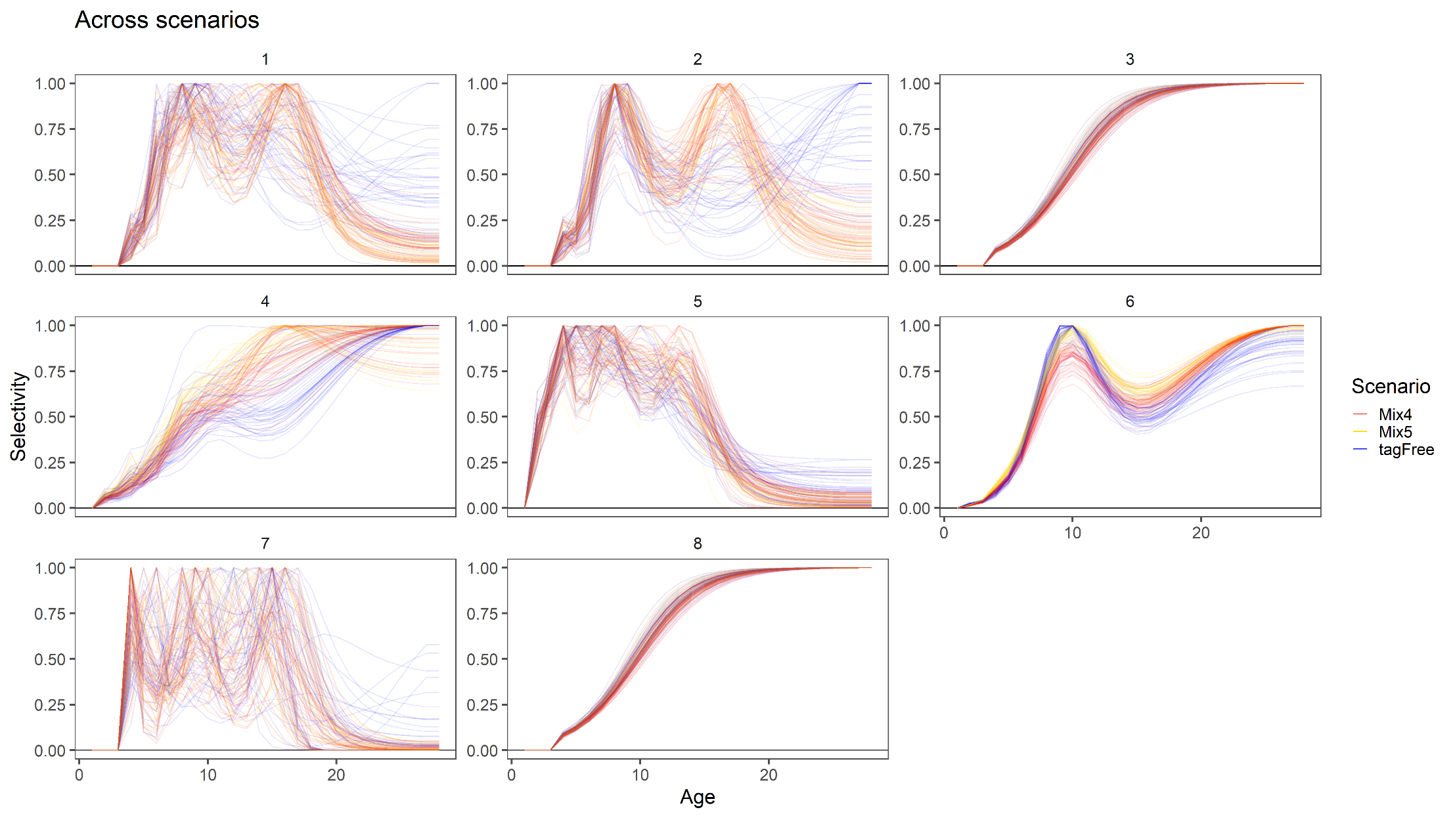
Single region replicates: selectivity
Flexible parametrization of selectivity curves (7 node cubic spline) gets taken for a ride.
Unconstrained fleets with fewer observations highly variable across replicates

Slide 9
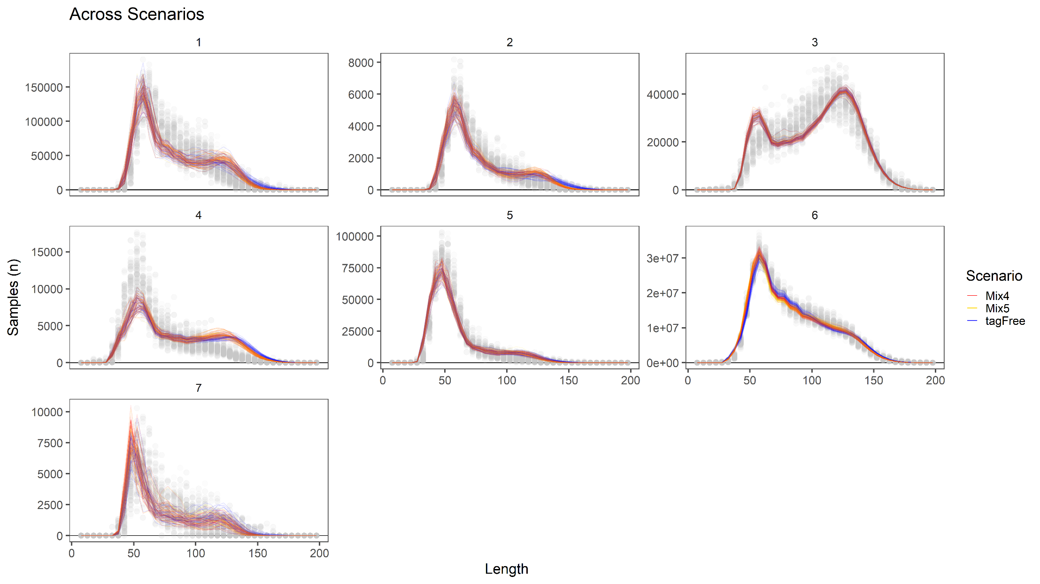
Single region replicates: length data
Consistent fits across replicates with similar residual pattern to final models
Similar fits between models with different treatment of tagging data

Slide 10
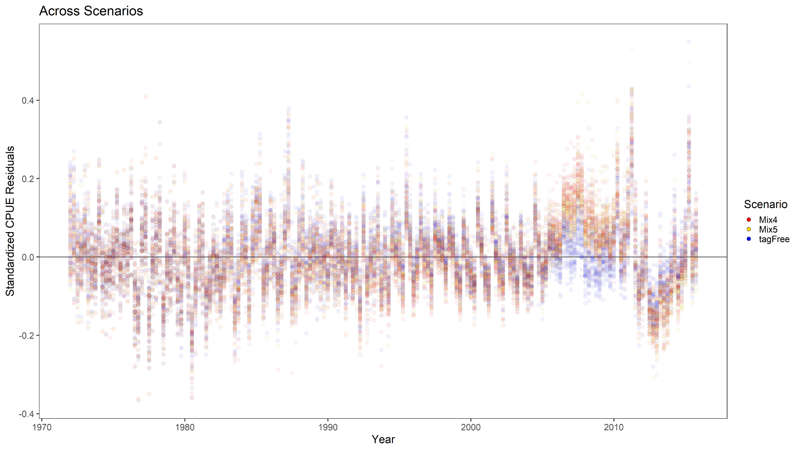
Single region replicates: CPUE residuals
Conflict with purse seine length composition data
Similar residual pattern to final models indicating persistent model mis-specification
Tag-free model shows less conflict with the CPUE
Conflict between tagging and CPUE data

Slide 11
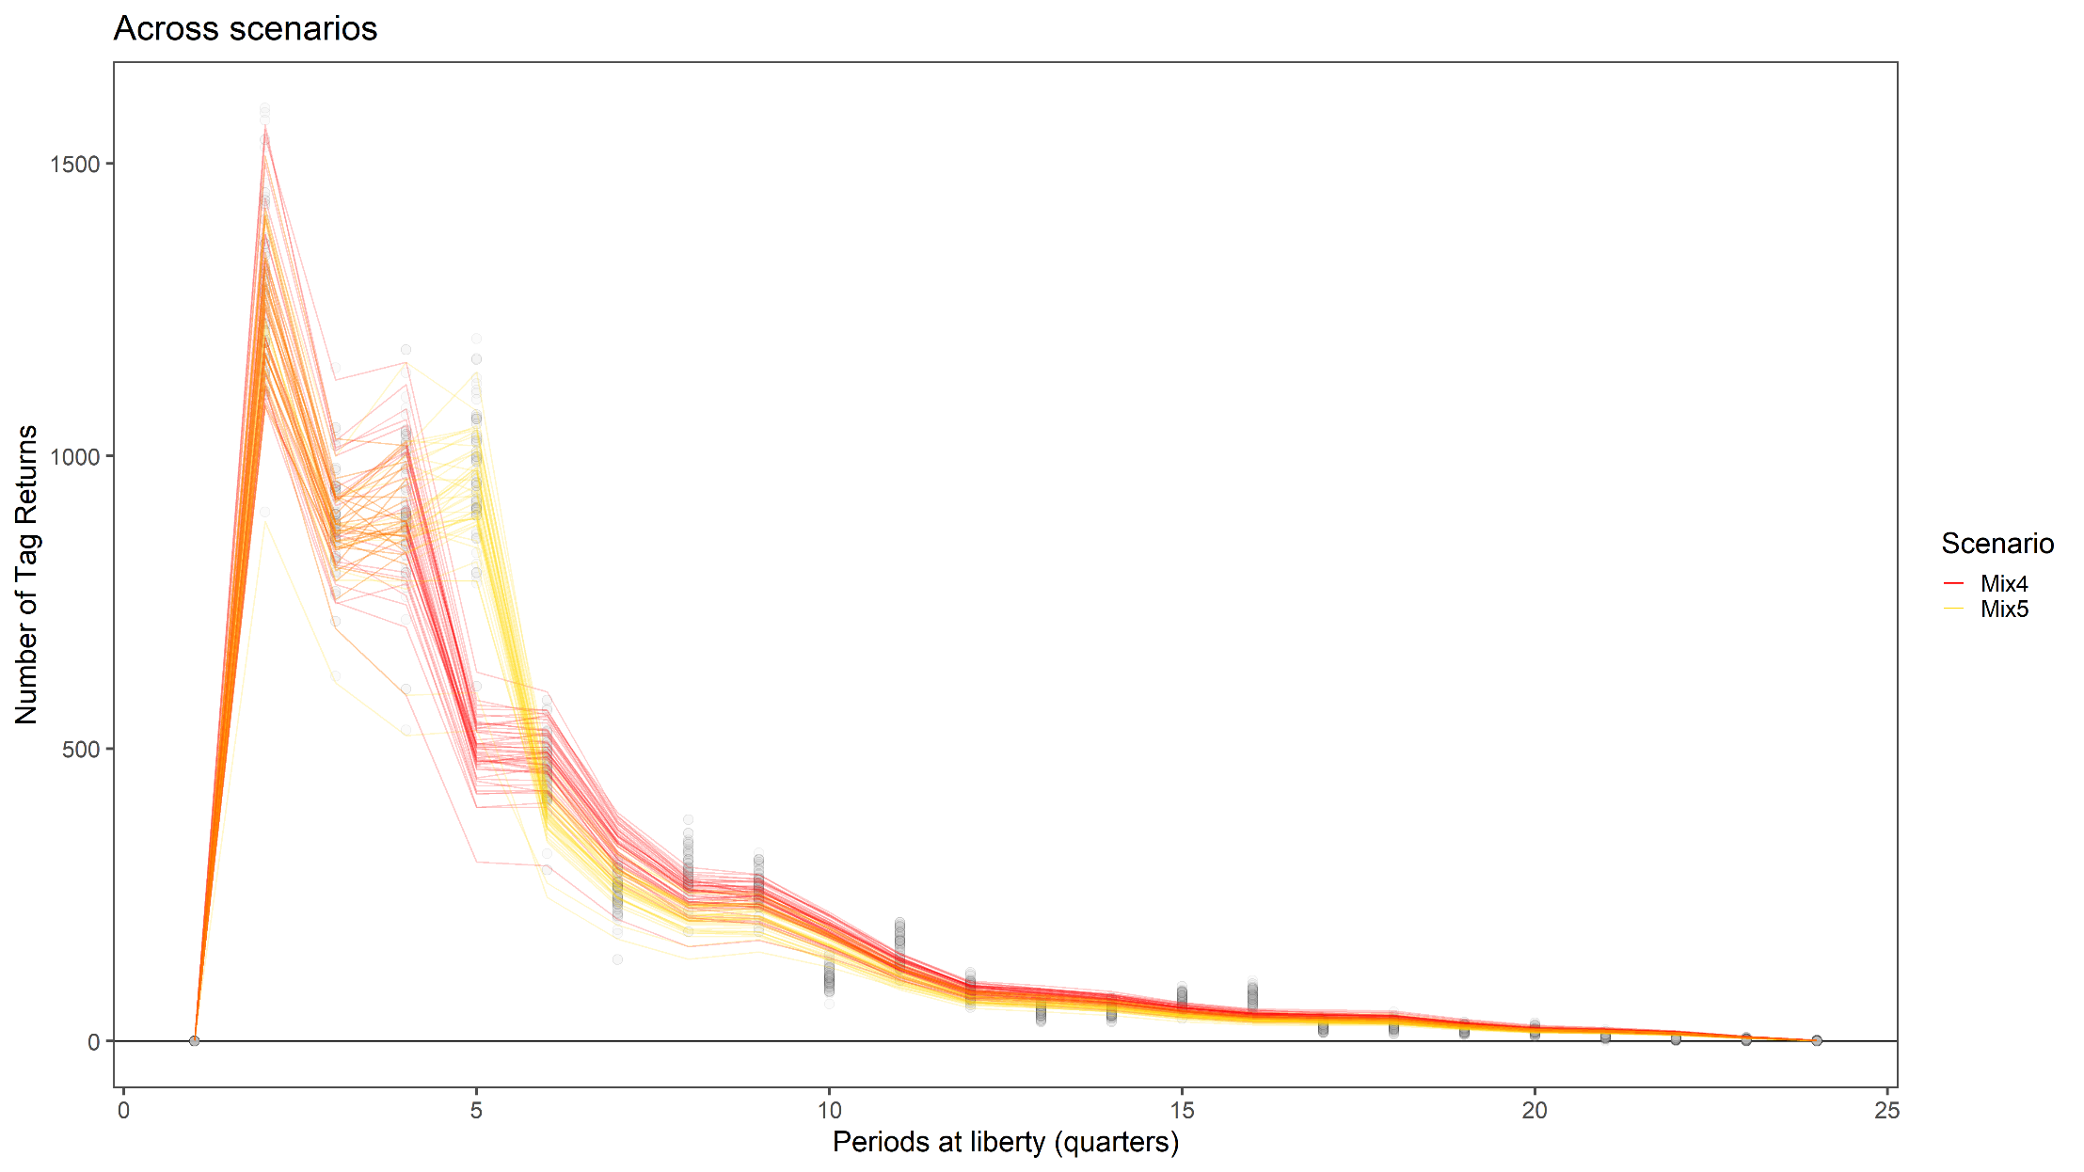
Single region replicates: length data
Models with mixing period of 4 all consistently miss the 5th quarter at liberty.
Otherwise fits are reasonably consistent

Slide 12
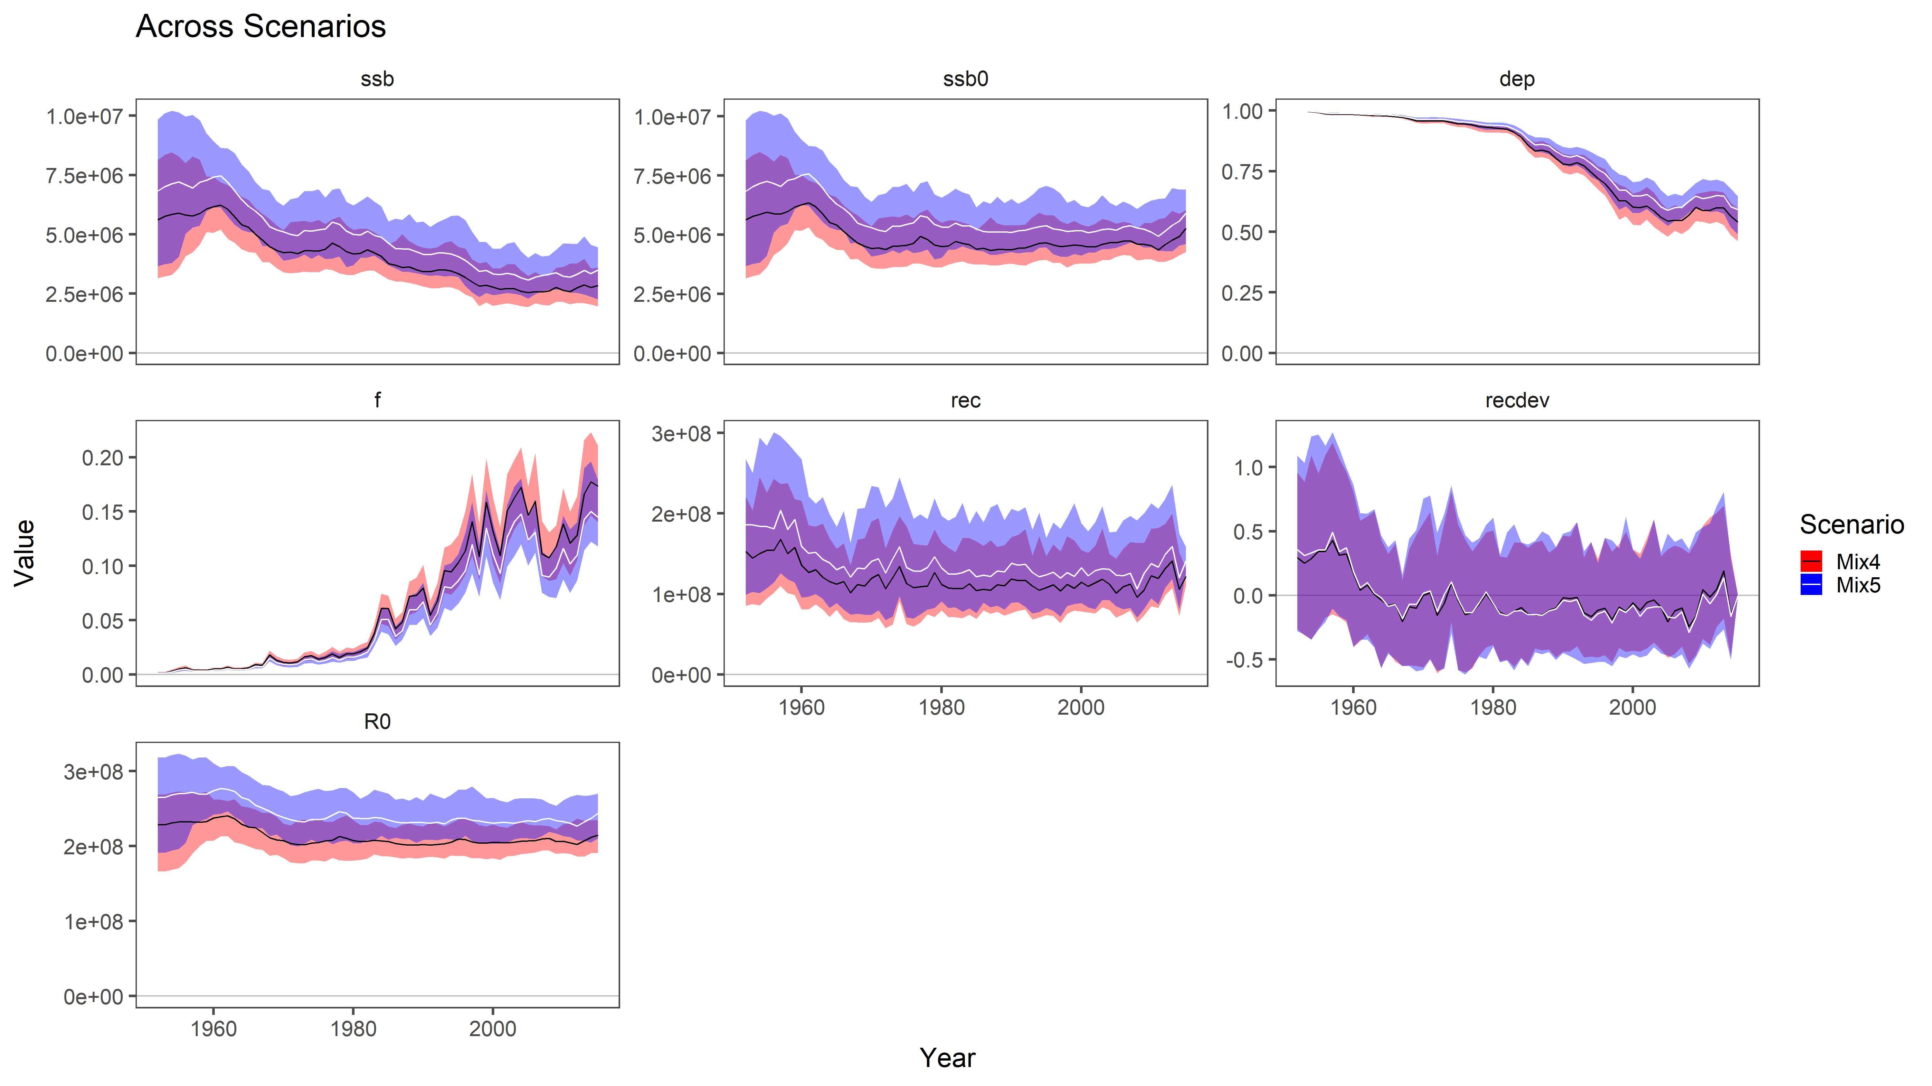
Four region replicates
Similar to single region model, Mix4 is slightly more pessimistic.
Residual patterns also largely similar to final four region model

Slide 13
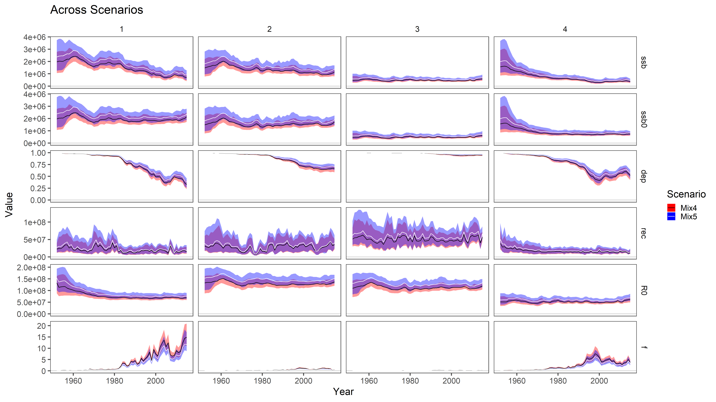
Four region replicates
Partitioning of biomass and fishing mortality by region.
Region 1 has highest spawning biomass and fishing mortality; most depleted
Region 3 has most recruitment; least depleted

Slide 14
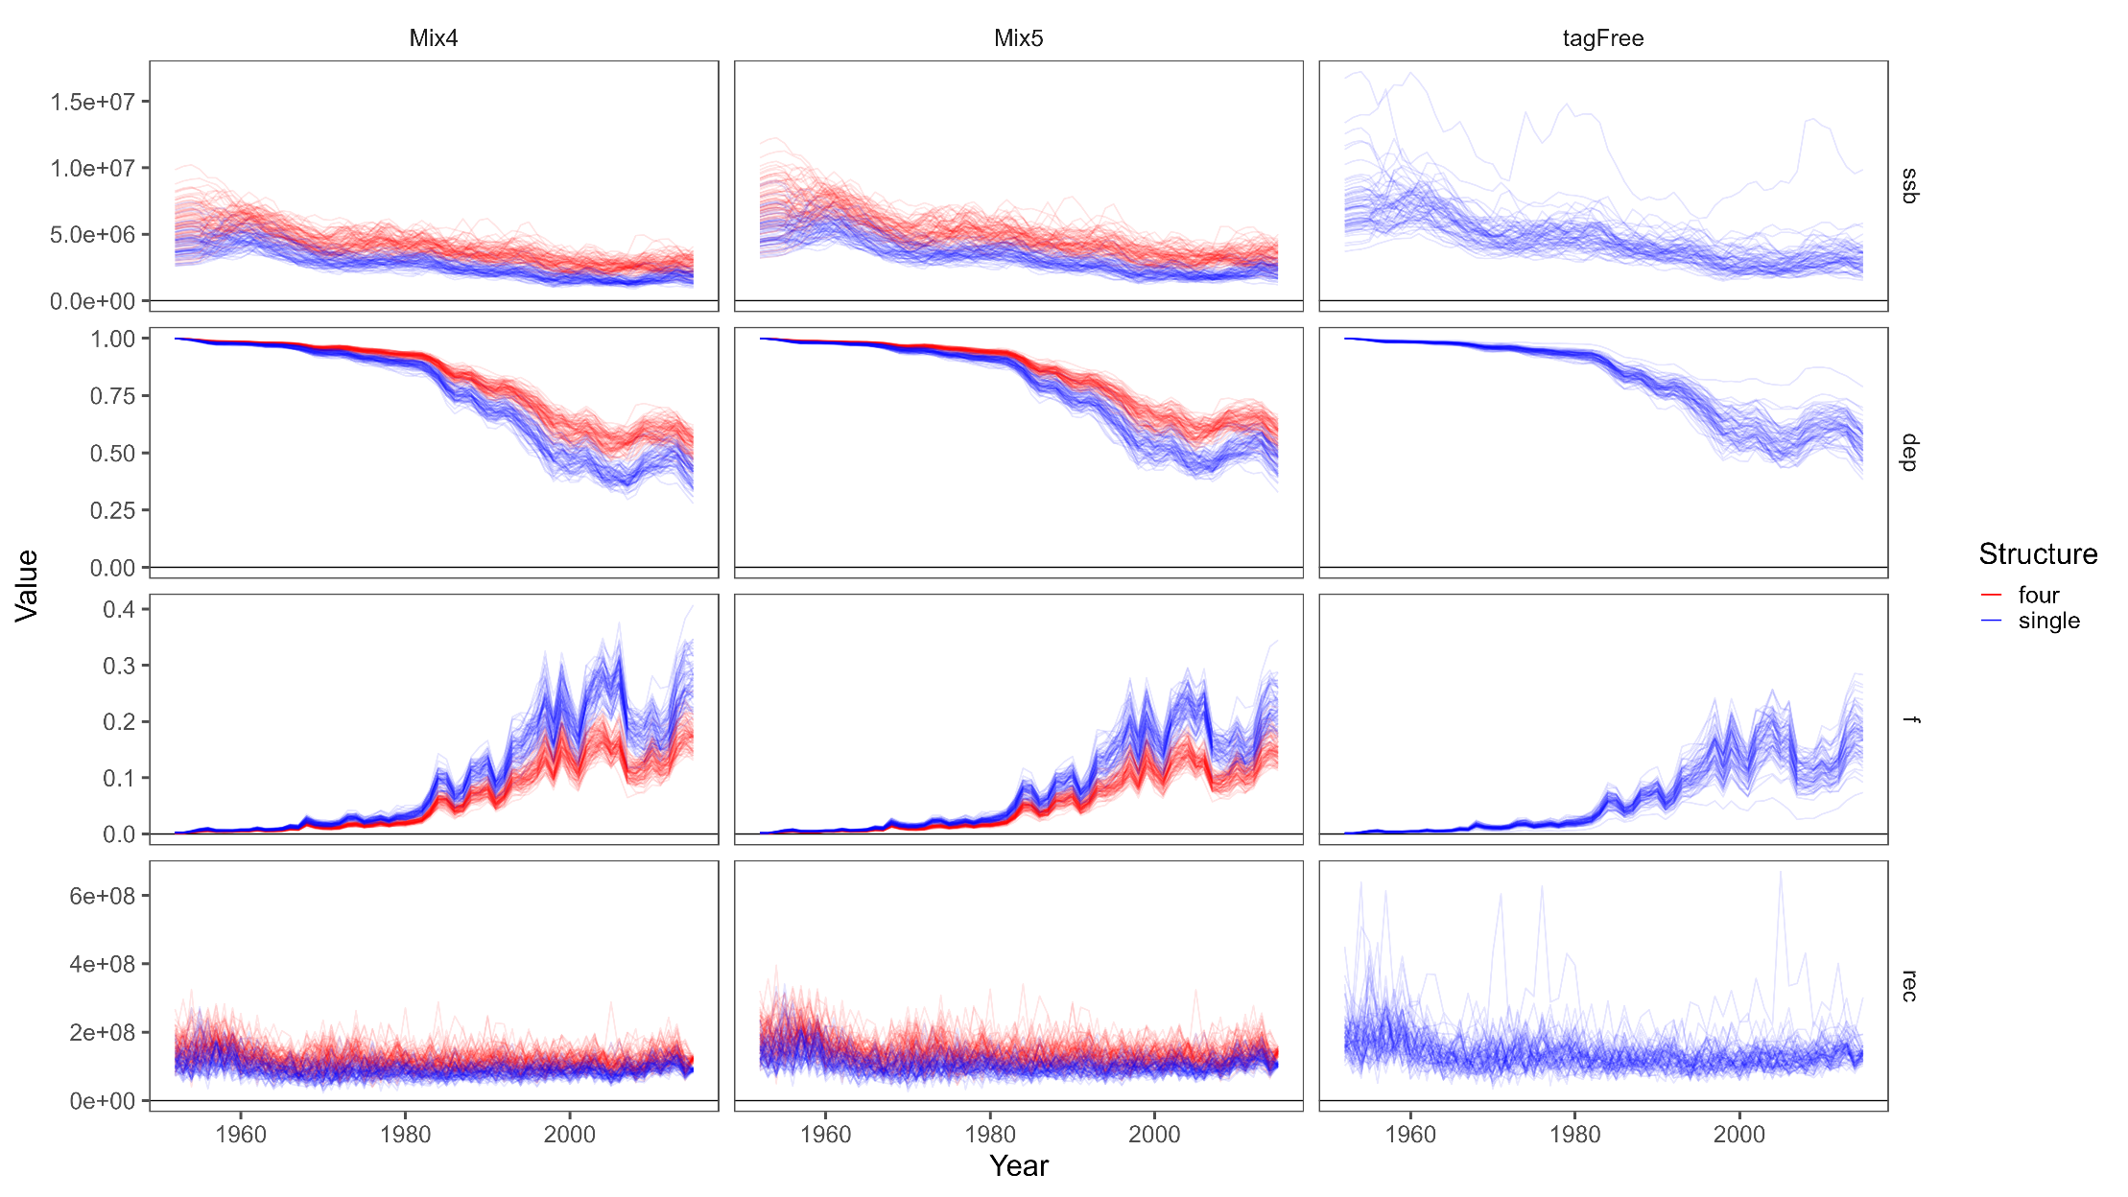
Comparison – Mean estimates
Four region model estimates higher scale, lower F, and more optimistic depletion than single region model

Slide 15
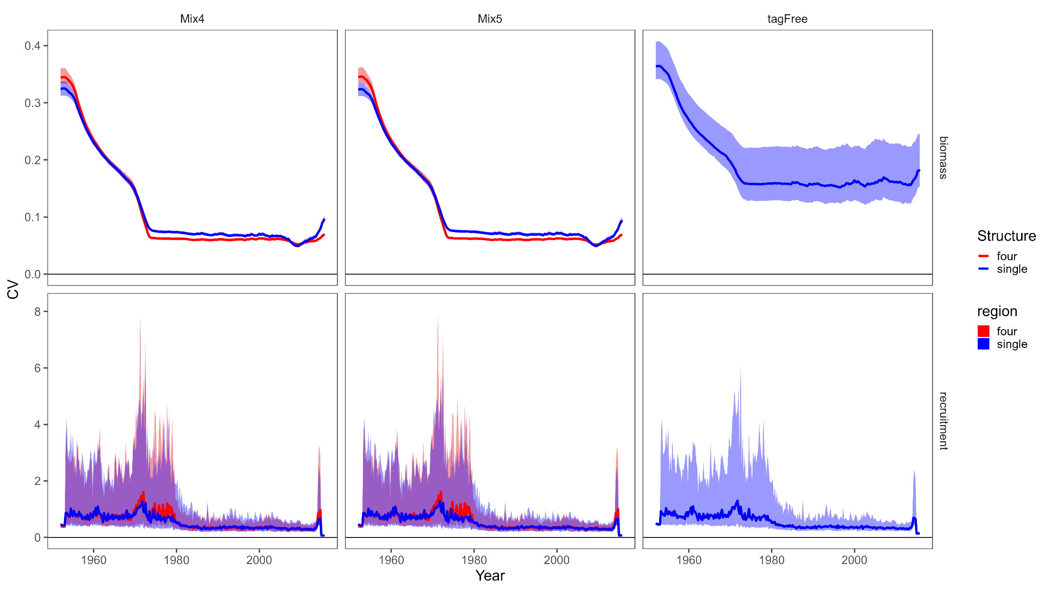
Comparison – CVs
CVs for aggregate biomass and recruitment are generally comparable between the two structures
CVs become tighter as CPUE & more length composition data comes online
Adding tagging data reduces uncertainty for biomass

Slide 16
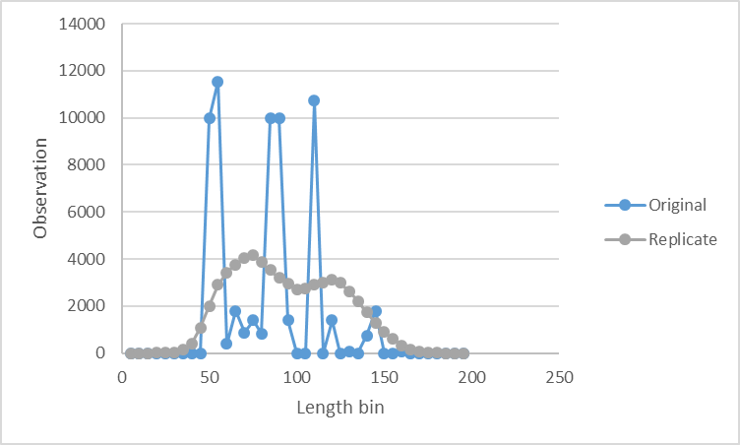
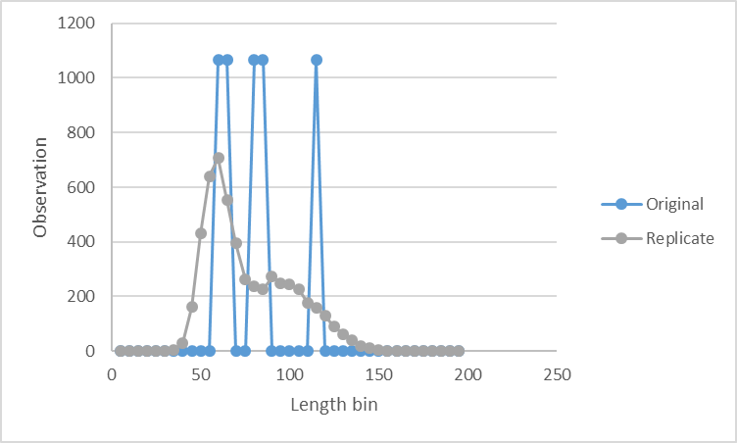
Replicate runs – 05x replicates vs. 00x replicates
Input sample sizes identical just allocated to length bins differently
Dirichlet multinomial estimates much higher effective sample size for 00x data >> more weight to length comps

Slide 17

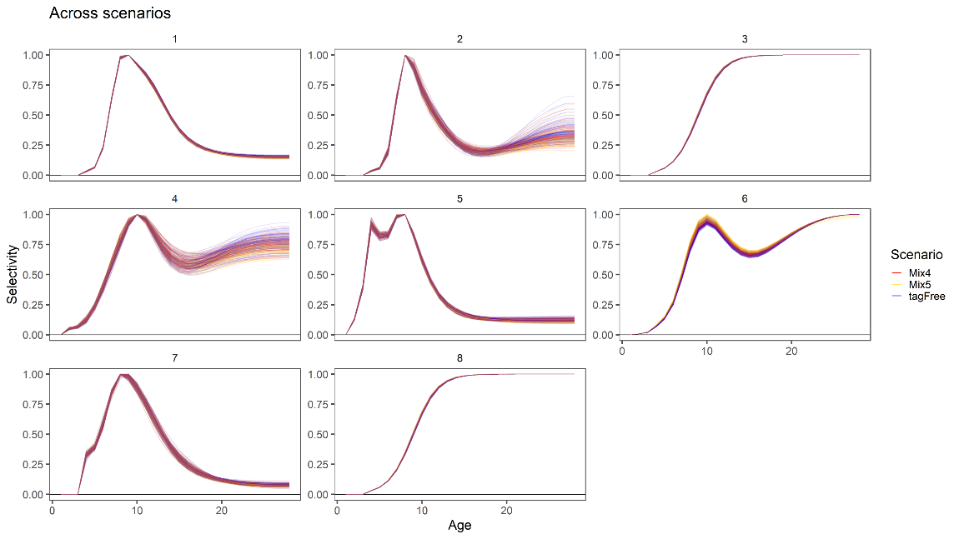
Replicate runs – 05x replicates vs. 00x replicates
05x
00x
Input sample sizes identical just allocated to length bins differently
Dirichlet multinomial estimates much higher effective sample size for 00x data >> more weight to length comps
Model estimates much more consistent between different treatments of tagging data and across replicates
00x estimates lower scale and depletion than 05x models (single & four region), most similar to Mix4 05x models
00x estimates Region 2 to have the most recruitment, and movement patterns appear to be different.

Slide 18
Final thoughts
Mis-specification apparent and both structures show similar residual patterns. Both structures assume almost identical fisheries since the four region model shared selectivity across regions.
Relax shared selectivity assumption in four region model and/or
Define new fisheries/regions based on analysis of 5x5 data
Model structures show differences in scale and depletion with single region showing lower scale and depletion.
Partitioning of fishing mortality and biomass in four region model can lead to buffering of overall status. Is this reasonable?
How important is it to get the details right?
Four region model estimates highest recruitment in region 3, and estimates very little movement out of regions 3 & 4. Though this is dependent on the weighting given to the length composition data (05x v. 00x)
Ideally tags should drive movement estimates but tags should also be allocated in a balanced way.
Does the importance of getting the details right depend on management regime (aggregate stock vs. regional specific reference points)?
Important to test multiple fishery/regional structures because despite assuming many correct values from the OM, models still show evidence of mis-fit and mis-specification.

